Slide 1
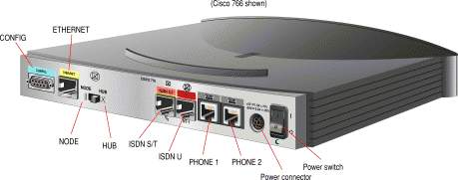
Router
Its a networking device to allow communication between 2 or more NETWORKS.
Types of routers:
1. Branch router
- used for small org.
- series: 800, 1800, 2800, 2900..
2. Internet-edge router
- used by mid-level orgs.
- series: 1000, 7000, 7500, 7560, 7600...
3. Service provide router
- used by WAN or big/huge orgs. like ISPs.
- series: 900, 1000, 7200, 7300, 7600...

Slide 2
Router components
The basic components of any Cisco router are :
Interfaces – for accessing routers
The Processor (CPU) – used for connecting with other device.
Internetwork Operating System (IOS) – it the Operating system (current: Cisco IOS XE 17.6.1)
RXBoot Image – aka boot loader, used when IOS is not in use (for maintenance purpose)
RAM - 32 to 64 MB
NVRAM - router holds its configuration
ROM – read-only memory that stores code like Bootstrap & POST.
Flash memory – it stores the router's operating system (IOS)
Configuration Register – determines if the router is going to boot the IOS image from its Flash, tftp server or just load the RXBoot image.

Slide 3
Routing
It is a process of selecting path/route along which the data can be transferred from source to destination.
Routing is done with the help of router.
Routing works on "network layer" of OSI model.
Routing works on "internet layer" of TCP/IP model.
Routing Algo. are used for routing the packets
Routing algorithm is responsible for deciding the optimal path.
Types of Routing:
Static routing
Default routing
Dynamic routing

Slide 4
Types of Routing – Static Routing
Aka Non-Adaptive Routing.
In this, administrator manually enters/adds routes in the routing table.
Advantage:
No overhead – no CPU usage, cheap.
No bandwidth – usage between routers.
Disadvantage:
Difficult for large networks.
Admins must have in-depth knowledge on the topology, as each route is added manually.

Slide 5
Types of Routing – Default Routing
It’s a technique in which a router is configured to sent all the packets to the same hop device.
It doesn’t matter whether if belongs to a particular network or net.
A PKT is transmitted to the device for which it is configured in default routing.
Default routing is used when networks deal with the single exit point.

Slide 6
Types of Routing – Dynamic Routing
AKA adaptive Routing
Here, router adds a new route response to the changes in the condition or topology of network.
Dynamic protocols are used to discover the new routes to reach the destination.
Protocols like RIP & OSPF
Advantages:
Easier to configure.
Disadvantage:
More expensive. Less secure than default & static routing.

Slide 7
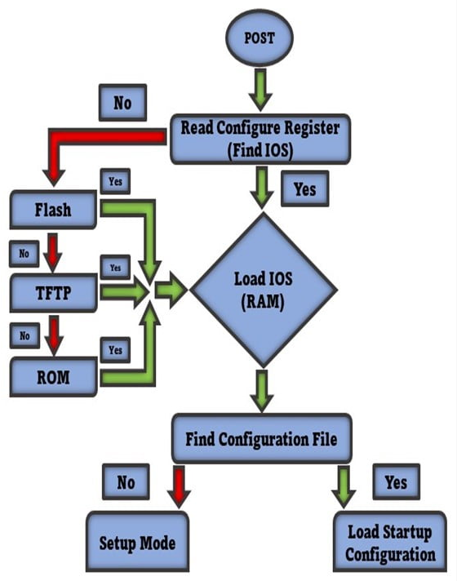
The Router Boot Sequence

Slide 8
The Router Boot Sequence
Router is powered on.
It performs POST (power on self-test).
Bootstrap program is loaded & executed (whenever IOS is found, load it)
Bootstrap reads configuration register values & loads the IOS.
If bootstrap fails, it will drop boot sequence & then move it to the ROMMON troubleshooting program.
If the IOS is loaded, it will try to load the config file.
Once the configuration is loaded then CLI interface will be present in front of you.

Slide 9
types of interfaces
Ethernet – physical interface, operates at 10Mbps (IEEE 802.3).
Fast Ethernet – physical interface, operates at 100Mbps (IEEE 802.3u).
Gigabit Ethernet – operates at 1000 Mbps (IEEE 802.3ab)
Serial – used for WAN connections from ISP.
FDDI – Fiber Distributed Data Interface, 100 Mbps, uses token-passing mech to prevent collisions.
Token Ring – can operate at either 4 Mbps or 16 Mbps

Slide 10
Cisco Discovery Protocol (CDP)
CDP is a network discovery tool, which assists network administrators and engineers in identifying neighboring Cisco devices, particularly those running lower-layer (data link layer), transparent protocols.
It is used to share information about other directly connected Cisco equipment, such as the operating system version and IP address.
CDP is a Cisco proprietary protocol that is used for collecting directly connected neighbor device information like hardware, software, device name details

Slide 11
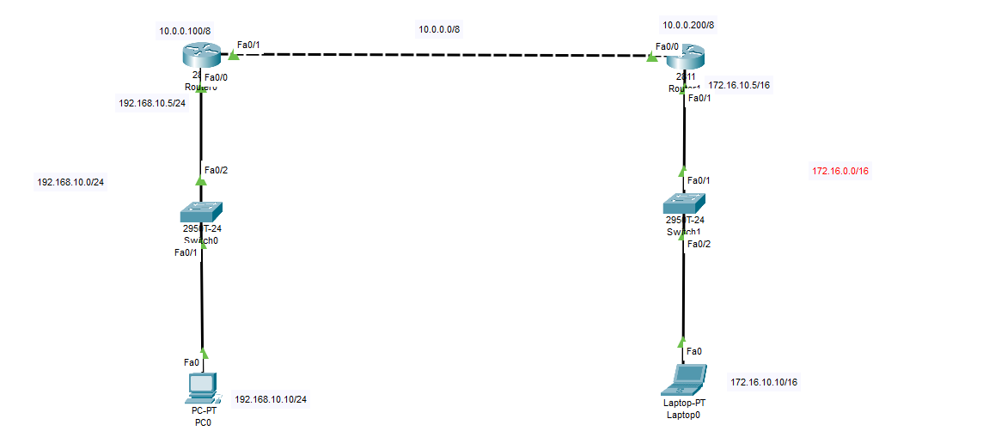
Static routing

Slide 12
Static routing - steps
Add PCs to the environment with IP, subnet & gateway.
Connect the PC with the switch.
Connect switch with the router (R1) with default gateway IP address.
Connect other interface with other network using different IP.
Enable IP route (via command)
Syntax: ip route <network id> <subnet mask><next hop>
Router(config)#ip route 172.16.0.0 255.255.0.0 10.0.0.200

Slide 13
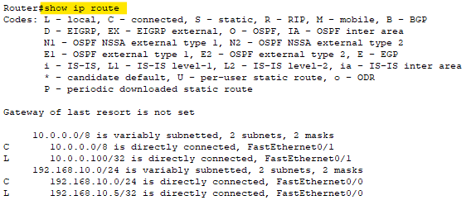
To list routing table

Slide 14
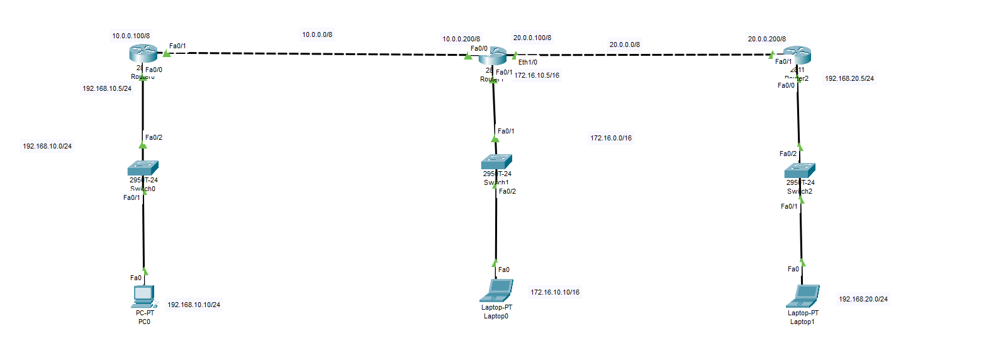
Trying with 3 routers

Slide 15
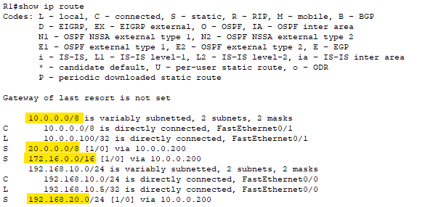
R1 Route config

Slide 16
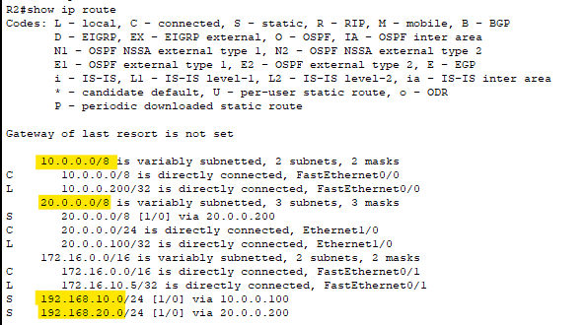
R2 Route config

Slide 17
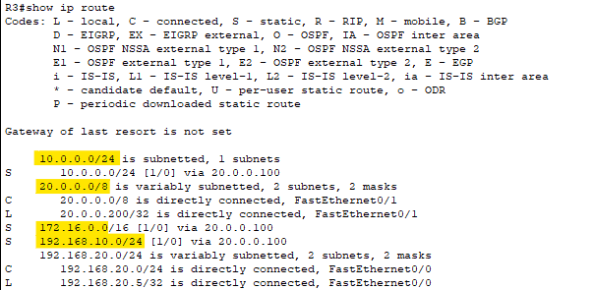
R3 Route config

Slide 18
Routing Terminologies
Administrative Distance
Metric
Hop
Bandwidth & Delay
Load & Reliability

Slide 19
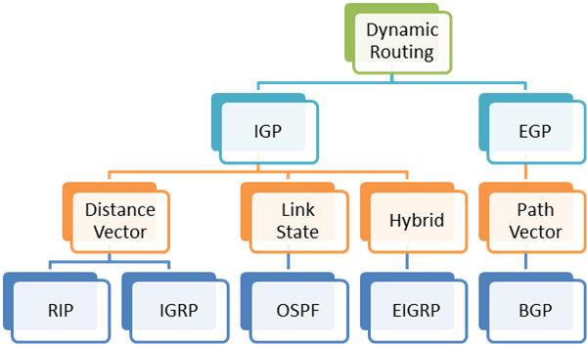
Dynamic routing
Dynamic routing is the process where routers automatically discover and adapt network paths to optimize data transmission.
Unlike static routing, where paths are manually configured, dynamic routing allows for flexibility and adaptability in complex networks.

Slide 20
Interior gateway protocol (IGP)
IGP is used within a single ‘autonomous system’.
An autonomous system is a network or a group of networks under a common administration and with common routing policies.
Examples of IGPs:
RIP (Routing Information Protocol)
OSPF (Open Shortest Path First)
EIGRP (Enhanced Interior Gateway Routing Protocol)
IS-IS (Intermediate System to Intermediate System)

Slide 21
Exterior Gateway Protocol (EGP)
is a type of routing protocol used to exchange routing information between different autonomous systems (ASes) on the internet.
Autonomous systems are distinct networks or groups of networks under separate administrative control, often managed by different organizations, such as internet service providers (ISPs) or large enterprises.
Example of EGP:
BGP (Border Gateway Protocol)
eBGP (External BGP): Used to exchange routing information between different ASes.
iBGP (Internal BGP): Used within an AS to ensure all routers have consistent BGP routing information, even though it's primarily an IGP.

Slide 22
Routing Information Protocol V1
It has 2 version RIPv1 & RIPv2.
Open standard protocol – supported in every networking device (like: Cisco, Juniper, etc.)
Classful routing protocol – subnetting not supported.
Updates are broadcasted (even to a Non-RIP configured router) via 255.255.255.255.
Metric based on: Hop count.
Maximum hops allowed: 15
Maximum routers allowed: 16 (1+15)
Supports load balancing.
Entire routing table is exchanged after every 30seconds.

Slide 23
RIP timer
Update timer
Time between consecutive updates.
30 seconds
Invalid timer
Time that router waits to hear updates.
The route is marked unreachable if there is no update during this interval.
180 seconds
Flush timer
Time before the invalid route is purged/removed from the routing table.
240 seconds

Slide 24
Advantages & disadvantages
Advantages:
Easy to configure
No design constraints
No complexity
Less overhead
Disadvantages:
Bandwidth utilization is very high as broadcast for every 30 seconds
Works only on hop count.
Not scalable as hop count is only 15.

Slide 25
Routing Information Protocol V2
Similar to RIPv1.
Supports classless routing protocol.
Supports VLSM
Auto summary can be done on every router.
Supports authentication.
Trigger updates
Uses multicast address: 224.0.0.9

Slide 26
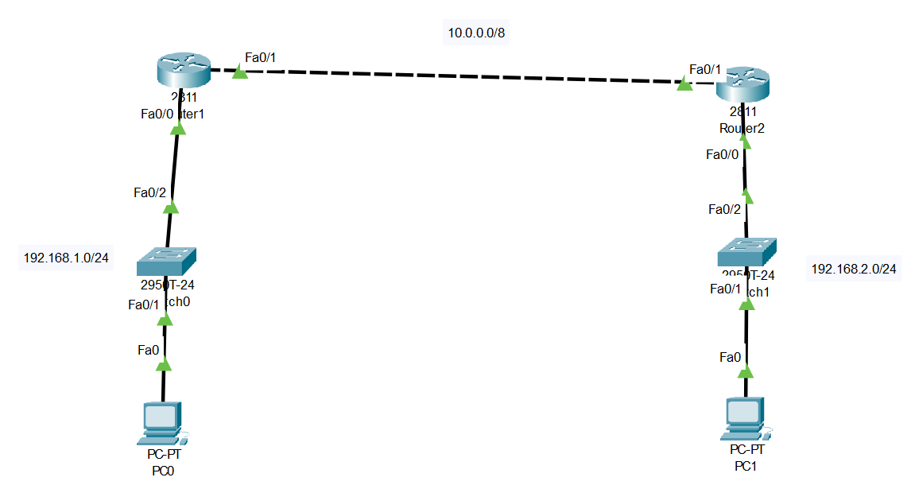
Configuring RIP

Slide 27
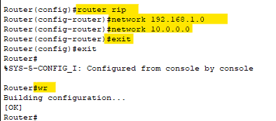
Router R1 config

Slide 28
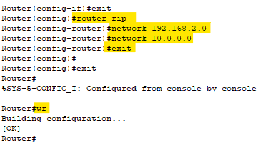
Router R2 config

Slide 29
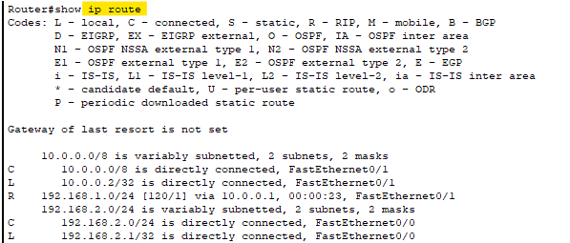
To list routing table – R1

Slide 30
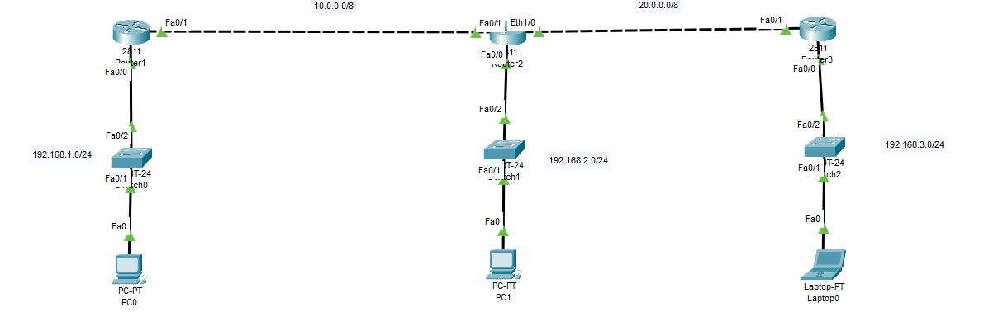
3 routers rip config

Slide 31
IGRP
Interior Gateway Routing Protocol.
Used for finding route in an autonomous system.
It’s a distance vector routing protocol (works on basis of hops).
Its cisco proprietary product.
It supports a maximum of 100 routers.
Metric based on: bandwidth, delay, reliability, load, MTU size.
Its classful routing protocol (fixed length subnet mask)
Consumes more bandwidth than EIGRP.
IGRP is not supported after IOS 12.3 release.

Slide 32
EIGRP
Enhanced Interior Gateway Routing Protocol.
It’s a hybrid routing protocol and has both characteristics of
Distance Vector Routing Protocol
Link State
It’s Cisco proprietary product.
Its successor of IGRP.
Metric based on: Bandwidth, Delay, Load, Reliability.
Convergence is faster, as it uses DUAL (Diffusing Update Algorithm)

Slide 33
EIGRP
Packet delivery is handled using:
Reliable transport protocol (RTP)
Reliable multicast on 224.0.0.10
EIGRP uses IP protocol number 88.
Uses variable length subnet mask (VLSM).
Classless routing protocol.
Loop free topology

Slide 34
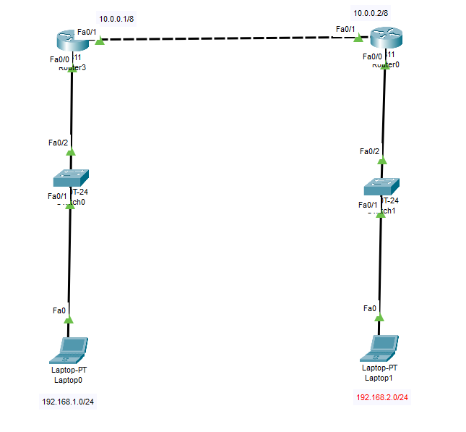
EIGRP with 2 routers

Slide 35
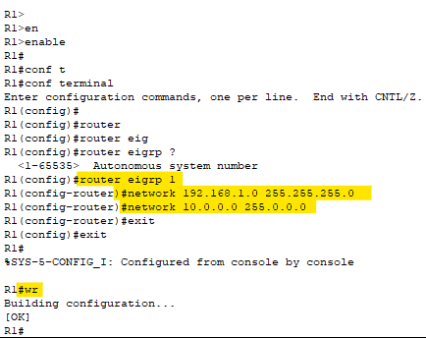
EIGRP on R1

Slide 36
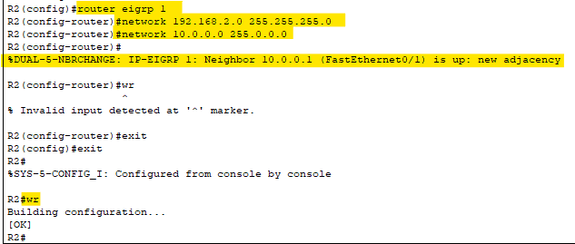
EIGRP on R2

Slide 37
OSPF
Open Shortest Path First.
Widely used protocol.
It is an Interior Gateway protocol (IGP).
It is a Link-state routing protocol.
After all the routers are connected to each other, all routers have same information about the network.
It sends LSA (Link State Advertisements), to get the information about
Subnet
Router
& some other information.

Slide 38
OSPF
OSPF stores all the LSA information in a database called LSDB.
Steps for OSPF working:
Becoming neighbors – two routers running OSPF on the same link agree to form a neighbor relationship.
Exchange database information – the neighbour routers swap their LSDB information with each other.
Choose the best routers – each router choose the best routes to add to its routing table based on the learned LSDB information.

Slide 39
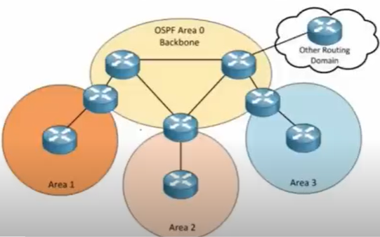
OSPF
It uses SPF (Shortest Path First) or DIJKISTRA algo.
Unlimited hop count.
It supports equal cost load balancing.
Introduced the concept of Area’s to ease management and control traffic.
All areas must be connect to area 0.
Supports authentication.
Uses multicast address: 224.0.0.5 & 224.0.0.6

Slide 40
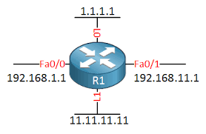
Router ID in OSPF
The highest IP address of the active physical interface of the router ID.
If logical interface is configured, the highest IP address of the logical interface is Router ID.
Loopback address gets the highest priority.

Slide 41
OSPF tables
OSPF maintains 3 tables:
Neighbor table
This table contains information about the directly connected OSPF neighbors forming adjacency.
Database table
This table contains information about the entire view of the topology with respect to each router.
Routing information table
Routing table contains information about the best path calculated by the shortest path first algorithm in the database table.

Slide 42
Wildcard
Subnet Mask | Wildcard mask
255.0.0.0 | 0.255.255.255
255.255.0.0 | 0.0.255.255
255.255.255.0 | 0.0.0.255
It’s the opposite of subnet mask.
For VLSM (128)
255.255.255.255 – 255.255.255.128 = 0.0.0.127

Slide 43
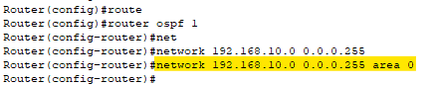
Syntax of OSPF command
Network <ip-address-range> <wildcard-mask> area 0

Slide 44
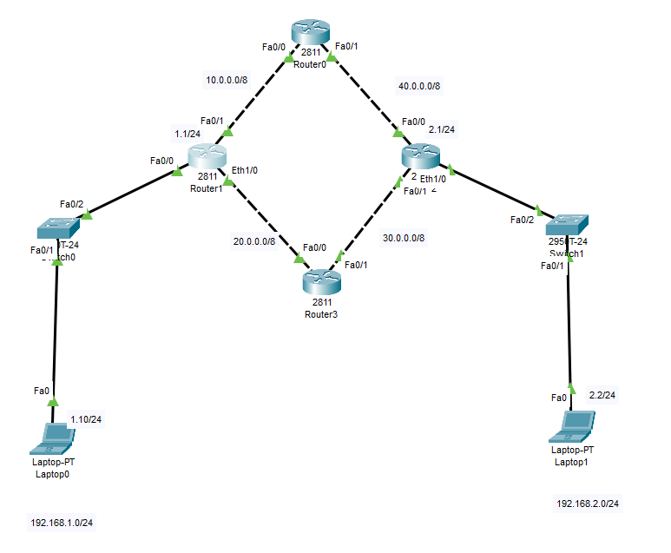
OSPF

Slide 45
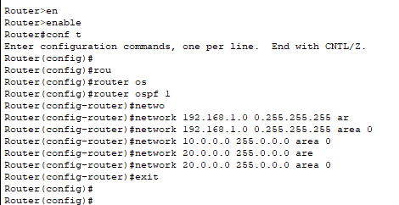
OSPF Configuration on Router R1

Slide 46
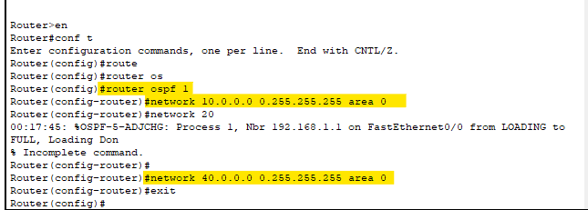
OSPF Configuration on Router R0

Slide 47
OSPF Configuration on Router R0

Slide 48
OSPF Configuration on Router R3

Slide 49
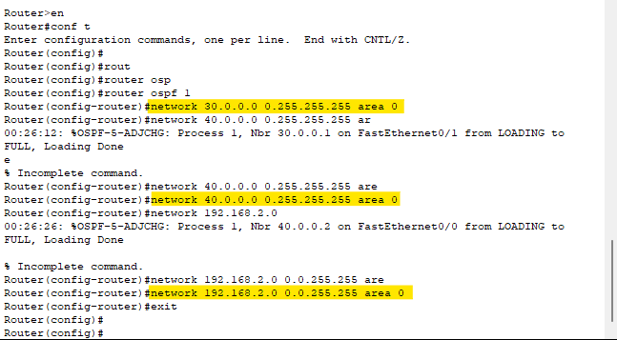
OSPF Configuration on Router R2

Slide 50
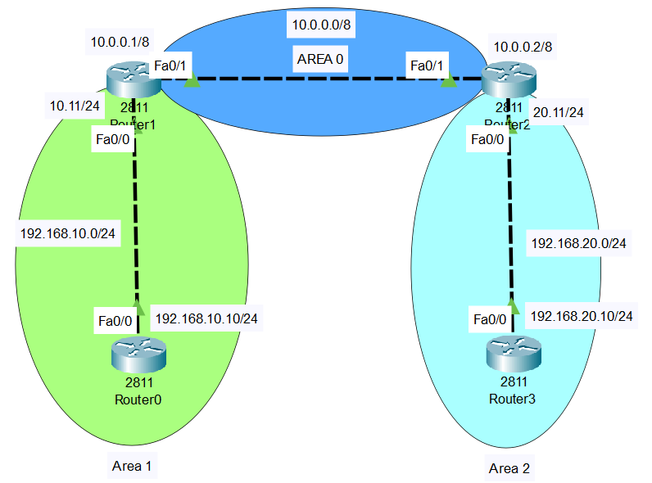
OSPF multi area

Slide 51
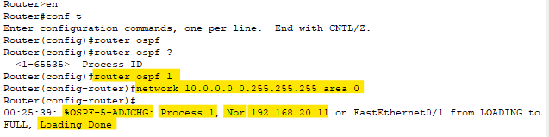
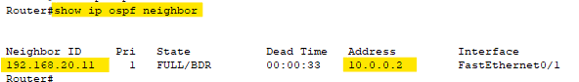
OSPF multi area – router 1 – area 0
Verify the neighbor on Router 1

Slide 52
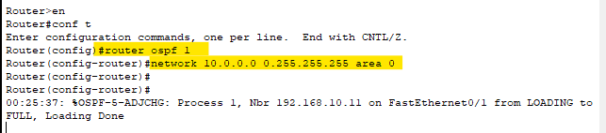
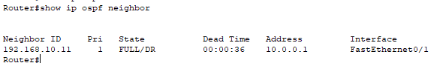
OSPF multi area – router 2 – area 0
Verify the neighbor on Router 2

Slide 53
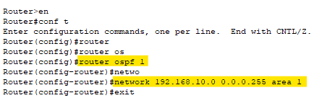
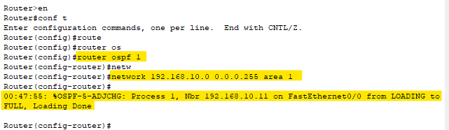
OSPF multi area – router 1 – area 1
Router 1
Router 0

Slide 54
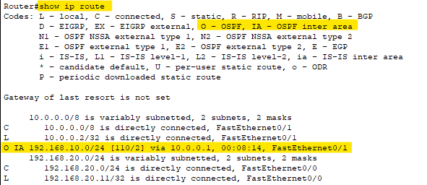
Listing routes – Router 2

Slide 55
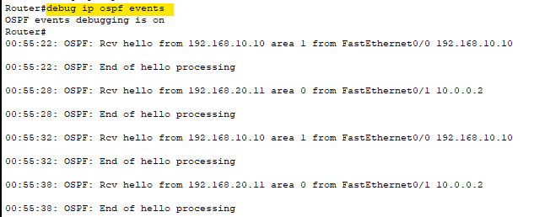
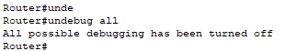
Listing OSPF events – router 1
To disable debugging:

Slide 56
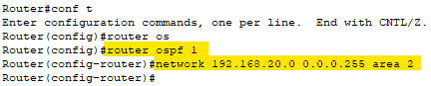
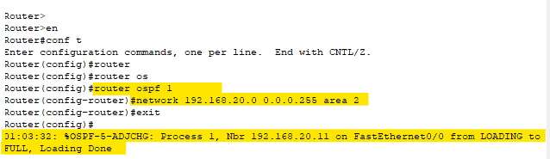
OSPF multi area – router 2 – area 2
Router 2
Router 3

Slide 57
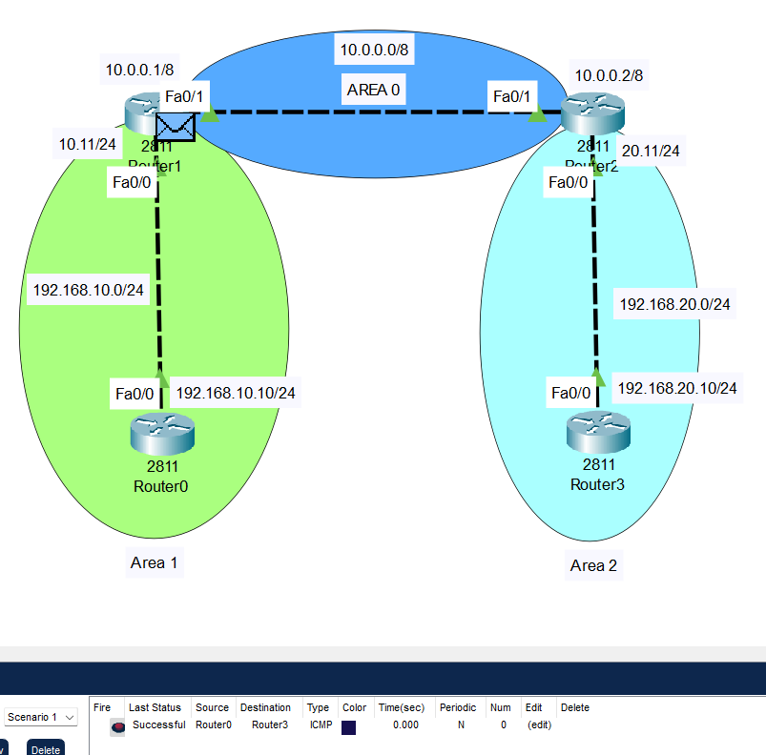
Pinging from router 0 to router 3

Slide 58
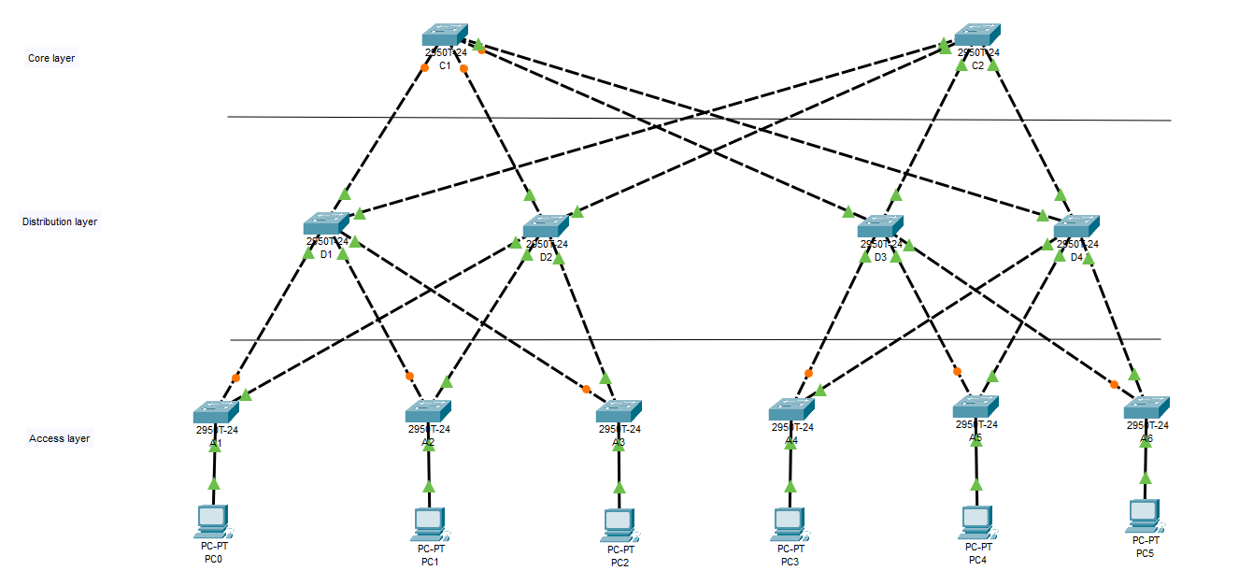

Slide 59
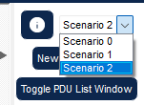
Task
Capture ARP details from PC2 to PC4 for the following network.
Delete the uplink between A1 & D2 switches and ping from PC0 to PC5
Delete the uplink between C1 & D4 & ping PC0 to PC5.
Delete D4 uplink & ping PC0 to PC5.
Delete C1 uplink & ping PC0 to PC5.
Note: for every task, create a new scenario.

Slide 60
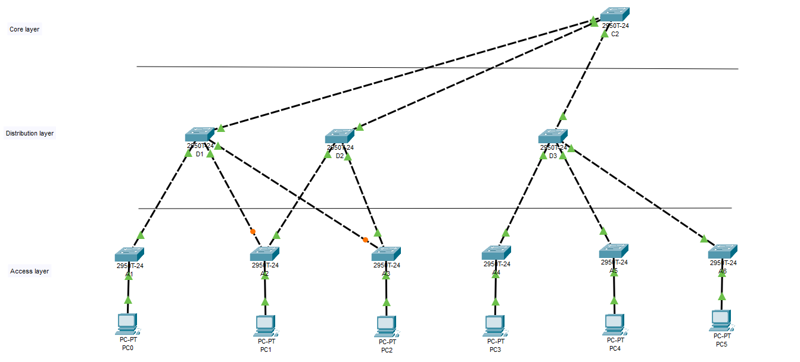
Final output

Slide 61
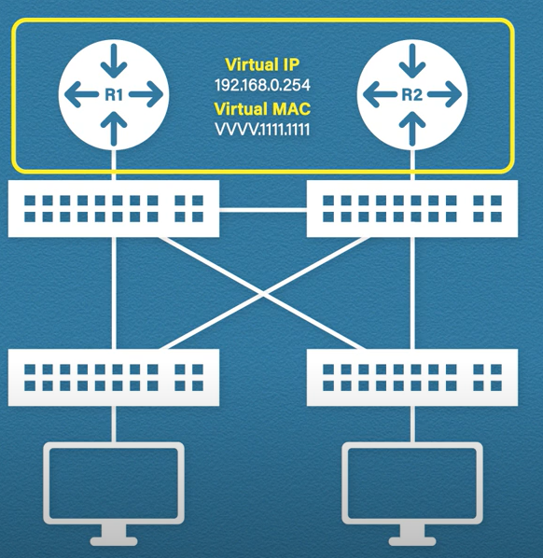
First Hop Redundancy Protocol
Ensures network availability by providing redundancy for the default gateway (first hop) in case of a failure.
FHRP allows multiple routers to share a virtual IP address that acts as the default gateway for hosts on a subnet.
If the primary gateway fails, the backup router automatically takes over, minimizing downtime.

Slide 62
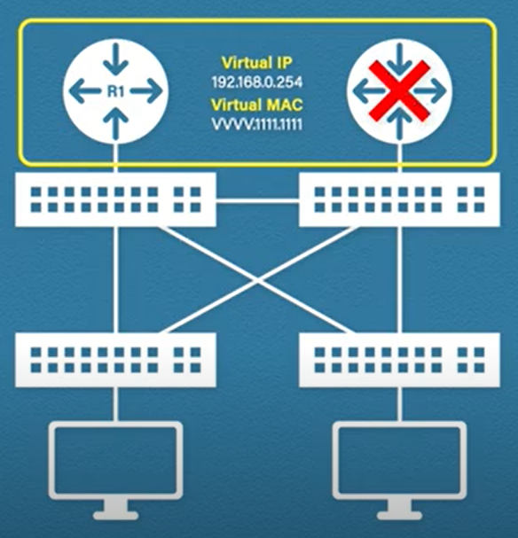
First Hop Redundancy Protocol
Common FHRPs:
HSRP
Hot Standby Router Protocol
Cisco proprietary, uses an active and standby router model.
VRRP
Virtual Router Redundancy Protocol
Open standard, similar to HSRP but with differences in election process and IP address usage.
GLBP
Gateway Load Balancing Protocol
Cisco proprietary, supports load balancing by allowing multiple active routers.

Slide 63
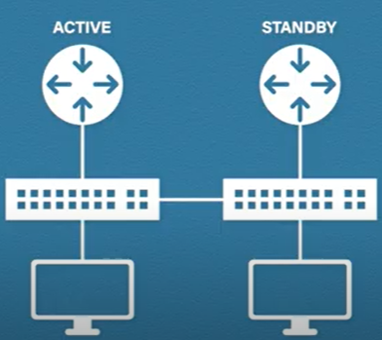
Hot Standby Router Protocol
HSRP multicast sends & receives multicast UDP hello packets every 3 seconds.
In Version 1, it uses 224.0.0.2 &
In Version 2, it uses 224.0.0.102
Virtual IP add is set for the group’s default gateway.
Active router election
Highest priority
Highest IP address

Slide 64
Hot Standby Router Protocol
Router sends “Hello” packet after every 3 seconds.
If any router fails, it “holds” for 10 seconds.
If no response till the hold time, then standby/passive announces itself as the “active” router and send the information to network to update the MAC address table.
If master (old) comes online, it will not replace the new master by default.

Slide 65
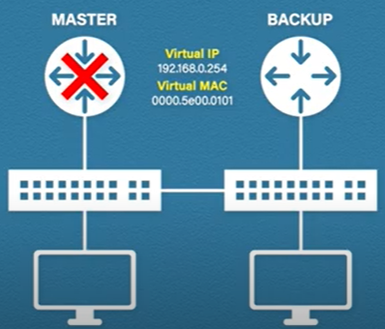
Virtual Router Redundancy Protocol
Here we have concept of Master router & Backup router.
Here, any 1 router will be assigned with a ‘virtual IP’, this makes this router as “IP address owner”.
Master router election happens on the priority of:
IP Address Owner
Highest Priority
Highest IP Address

Slide 66
Virtual Router Redundancy Protocol
Unlike HSRP, the messages within the network is only sent by “master router”.
Master router sends the multicast packets to address: 224.0.0.18
The advertisements are sent every 1 second by default.
It (master) has a downtime of 3 seconds.
& then “backup” router will assume the role of “master” router & announces itself to the network.
If the master (old) router comes online again, it will “takeover” as master router once again.

Slide 67
Gateway Load Balancing Protocol
GLBP is similar to HSRP, as it’s a Cisco proprietary.
Like HSRP, each router will send “hello” message to the network after every 3 seconds.
It uses multicast address: 224.0.0.102
& UDP port: 3222
Active router election is similar to HSRP
In GLBP, it assigns ‘virtual MAC’ address to each router.

Slide 68
FHRP table for exam
 | Standard | Router roles | Multicast address | MAC address | No. of virtual MAC address
HSRP | Cisco proprietary | Active/Standby | 224.0.0.2 224.1.1.102 | 000.0C07.ACXX | ONE
VRRP | RFC 5798 (open standard) | Master/Backup | 224.0.0.18 | 0000.5e00.01XX | ONE
GLBP | Cisco proprietary | Active/Standby | 224.0.0.102 | 0007.b400.XXYY | Four (shared)

Slide 69
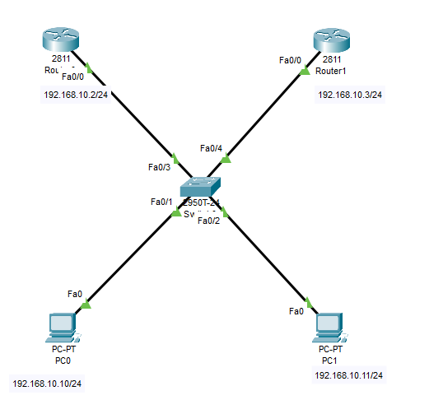
Hot Standby Router Protocol
PC0 = 192.168.10.10/24
DGW(PC0) = 192.168.10.1
PC1 = 192.168.10.11/24
DGW (PC1) = 192.168.10.1
Router0 = 192.168.10.2/24
Router1 = 192.168.10.3/24

Slide 70
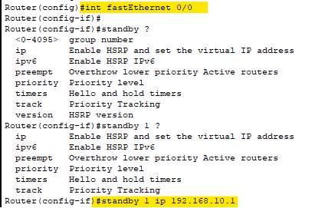
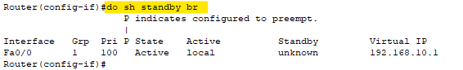
HSRP configuration – Router 1

Slide 71
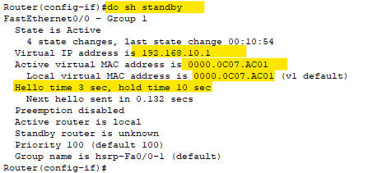
HSRP configuration – Router 1

Slide 72
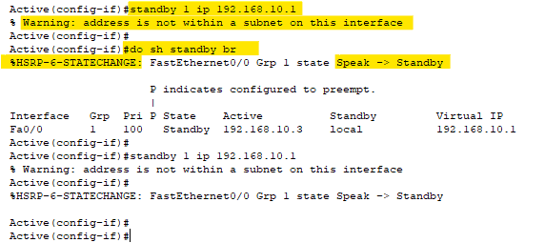
HSRP configuration – Router 0

Slide 73
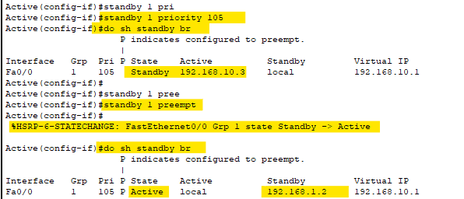
HSRP configuration – changing priority
By changing priority, stand by router becomes active.
forcefully changing the router mode.

Slide 74

HSRP configuration – delete router 0
Just delete the link for the active & wait for 3 seconds. & verify on Router1

Slide 75


HSRP configuration – reactivation of R0

Slide 76

Redistribution
Redistribution involves sharing routes between different routing protocols, allowing for interoperation in complex network environments.
Redistribution can occur between various routing protocols like OSPF, EIGRP, BGP, RIP, and others.
Redistribution can be one-way (routes from one protocol are redistributed into another) or two-way (routes are shared between both protocols).
When redistributing routes, metric values must be converted appropriately to match the receiving protocol's metric type (e.g., cost, hop count).
Redistribution can lead to routing loops if not configured carefully, especially with two-way redistribution.

Slide 77

Redistribution on EIGRP & RIP

Slide 78


Configuring EIGRP on R0

Slide 79

Configuring EIGRP on R1

Slide 80

Configuring RIP on R1

Slide 81

Configuring RIP on R2

Slide 82

Configuring Redistribution on R1
Metric value: “Bandwidth” + “Delay” + “Load” + “MTU” + “Reliability”

Slide 83

Validating routes on R0

Slide 84

Configuring EIGRP under RIP on R1

Slide 85

Validating routes on R2

Slide 86

Redistribution on EIGRP & OSPF

Slide 87

On Router R0:

Slide 88


On Router R1:
Listing neighbours on R1:

Slide 89

Configuring OSPF on Router R1

Slide 90

Configuring OSPF on Router R2

Slide 91

Listing OSPF external entry on Router R1:

Slide 92

On Router R1, redistributing OSPF, under EIGRP

Slide 93

On Router R1, redistributing EIGRP, under OSPF

Slide 94

Border Gateway Protocol (BGP-4)
It’s an inter-domain routing protocol.
It uses a path-vector algorithm for best path selection.
It uses TCP port 179 for connection establishment.
Neighbors are explicitly defined.
Before sending the packet from one network to another BGP will have 3-way handshake.

Slide 95

Border Gateway Protocol (BGP-4)
Public AS: 1 – 64511
Private AS: 64512 – 65535
There are many versions of BGP, such as:
BGP version 1: This version was released in 1989 and is defined in RFC 1105.
BGP version 2: It was defined in RFC 1163.
BGP version 3: It was defined in RFC 1267.
BGP version 4: It is the current version of BGP defined in RFC 1771.

Slide 96
How BGP is different?
In IGP, you cannot configure neighbors explicitly.
In BGP, you can even through they are not connect directly.
Unlike, IGP, BGP advertise the whole subnet, instead of advertising the individual network.
BGP can be configured
Within AS (IBGP)
In between AS (EBGP)

Slide 97

IBGP (Internal BGP)
If all the routers are neighbors of each other and belong to the same autonomous number system, the routers are referred to as an IBGP.

Slide 98

EBGP (External BGP)
If all the routers are neighbors of each other and they belong to the different autonomous number systems, then the routers are referred to as an EBGP.

Slide 99
Types of Packets in BGP
Open
When one router wants to connect to another router and wants to create a neighborhood relation, it uses the open message.
Update
It is used in two situations:
It is used to withdraw a destination that has been previously advertised.
It is also used to announce a route to a new destination.
Keep Alive
Such a message is exchanged regularly.
It is used to tell other routers if they are alive or not.
For example, ‘Hello’ packets.
Notification
It is sent by a router when there is an error condition.
It is also sent by the router when it wants to close a connection.

Slide 100

Border Gateway Protocol - Demo

Slide 101

Router configuration on R0:

Slide 102

Router configuration on R1:

Slide 103

Display protocol details on Router R0:

Slide 104

Display protocol details on Router R1:

Slide 105

BGP TASK

Slide 106

Policy Based Routing (PBR)
PBR forces specific traffic over a specific path.
PBR could over-ride the default behavior of working on a specific router.
To implement PBR:
Create an ACL to define the traffic that should be based on PBR.
Create route map (if/then) statement.
Apply the route map to the interface.

Slide 107
Policy Based Routing (PBR)
Allows network administrators to override traditional routing decisions based on policies rather than solely on destination IP addresses.
Enables fine-grained control over traffic paths, allowing prioritization of specific traffic flows or bypassing of certain paths.
Can be used to distribute traffic across multiple paths, ensuring better utilization of available resources.
Typically configured on routers and Layer 3 switches through access control lists (ACLs) and route maps.
PBR allows forwarding decision based on:
Source IP address
Destination IP address
Protocol Type (HTTP, HTTPS, etc.)

Slide 108
IPv6
IPv6 is the next-generation Internet Protocol, designed to replace IPv4, which is running out of available addresses.
IPv6 uses 128-bit addresses, allowing for approximately 340 undecillion (3.4 x 10^38) unique addresses, compared to the 32-bit addressing system in IPv4, which supports about 4.3 billion addresses.
IPv6 addresses are written in eight groups of four hexadecimal digits, separated by colons (e.g., 2001:0db8:85a3:0000:0000:8a2e:0370:7334).
Due to its vast address space, IPv6 eliminates the need for Network Address Translation.
IPv6 includes IPsec as a mandatory feature, providing better support for encryption, authentication, and secure data transmission.

Slide 109

IPv4 VS IPv6

Slide 110

IPv6 address types

Slide 111
IPv6 address types
Unicast address
The unicast address specifies a single interface. A packet sent to a unicast address destination travels from one host to the destination host.
Types of unicast addresses:
Link-Local address
Link-local addresses are designed for use on a single local link (local network).
Link-local addresses are automatically configured on all interfaces.
The prefix used for a link-local address is fe80::/10.
Global address
Global addresses are designed for use on any network. The prefix used for a global address begins with binary 001.

Slide 112
IPv6 address types
Special types of unicast addresses:
Unspecified address
The unspecified address is 0:0:0:0:0:0:0:0.
You can abbreviate the address with two colons (::).
The unspecified address indicates the absence of an address, and it can never be assigned to a host.
Loopback address
The loopback address is 0:0:0:0:0:0:0:1.
You can abbreviate the address as ::1.
The loopback address is used by a node to send a packet to itself.

Slide 113
IPv6 address types
Anycast address
An anycast address specifies a set of interfaces, possibly at different locations, that all share a single address.
Multicast address
The multicast address specifies a set of interfaces, possibly at multiple locations.
The prefix used for a multicast address is ff.
If a packet is sent to a multicast address, one copy of the packet is delivered to each member of the group.

Slide 114

Wide-Area Network
A wide-area network (WAN) is a collection of local-area networks (LANs) or other networks that communicate with one another.
A WAN is essentially a network of networks, with the Internet the world's largest WAN.
WAN links define a new type of L1 & L2 connectivity.
Allows links to the internet or other offices.

Slide 115

WAN Terminology

Slide 116
WAN Terminology
CPE (Customer Premises Equipment) are all devices, wiring, and hardware that are located at the site of the customer.
Demarcation point (demarc) is where the service provider’s wiring ends and where the customer’s wiring begins.
DTE (Data Terminal Equipment) is the customer device that forwards data from the customer’s network to the WAN. This can be a router, computer or sometimes a switch.
CSU/DSU (Channel Service Unit / Data Service Unit)
is a device that sits in between the router and WAN connection.
It converts digital signals from the WAN into a digital signal the router understands and vice versa.

Slide 117
WAN Terminology
DCE (Data Circuit-terminating Equipment)
is the device that receives data from the DTE, modulates into an analog signal and forwards it onto the wire to the service provider.
It also demodulates analog signals that it receives on the wire into digital signals.
Local loop is the physical link that connects from the demarcation point at the customer to the edge of the service provider network.
CO (Central Office) is the building where all lines from local loops to the customers end up.

Slide 118

WAN Technologies
There are a number of different methods how we can forward data on a network:
Circuit switching

Slide 119

WAN Technologies
There are a number of different methods how we can forward data on a network:
Packet switching
The idea behind it is that we break our data down in “chunks”. Each chunk is a packet that is sent on the network. This is what we mostly use on our networks nowadays.

Slide 120

WAN Technologies
There are a number of different methods how we can forward data on a network:
Cell switching
Cell switching is very similar to packet switching with the exception that we use a fixed for our size for our cells.

Slide 121
Other Types of WAN technologies
TCP/IP protocol suite
Router
Overlay network
Packet over SONET/SDH (PoS)
Multiprotocol Label Switching (MPLS)
ATM (Asynchronous Transfer Mode)
Frame Relay

Slide 122
Multi Protocol Label Switching (MPLS)
MPLS is an IP packet routing technique that routes IP packet through paths via labels instead of looking at complex routing tables of routers.
This feature helps in increasing the delivery rate of IP packets.
MPLS uses layer 3 service i.e, Internet Protocol, and uses router as forwarding device.
The traffic of different customers is separated from each other because MPLS works somewhat like VPN.
An MPLS header is added to packet that lies between layers 2 and 3. Hence, it is also considers to be Layer 2.5 protocol.

Slide 123

MPLS Header
The MPLS Header is 32 bit long and is divided into four parts –
Label – This field is 20 bit long and can take value b/w 0 & 220 – 1.
Exp – They are 3 bits long and used for Quality of Service(QoS).
Bottom of stack (S) – It is of size 1 bit. MPLS labels are stacked one over other. If there is only one label remained in MPLS header, then its value is 1 otherwise 0.
Time to Live (TTL) – It is 8 bit long and its value is decreased by one at each hop to prevent packet to get stuck in network.

Slide 124
Important terms
Provider Edge(PE) Router - Router at edge of MPLS network that add or remove label from IP packet.
Customer Edge(CE) Router - Router at edge of customer network that send or receive IP packet from PE.
Label Switch Router(LSR) - Routers used in MPLS network that can understand labels.
Ingress LSR - LSR routers that receive IP packet from CE Routers and add MPLS header.
Intermediate LSR - LSR routers that swap label in MPLS header and assigned for forwarding labeled IP packet.
Egress LSR - LSR routers that send IP packet to CE routers and removes MPLS header.
Push, Pop and Swap - Action of addition, removal and swapping of labels by LSR respectively.

Slide 125
Transmission
Transmission is the action of transferring or moving something from one position or person to another. It is a mechanism of transferring data between two devices connected using a network. It is also called communication Mode.
In computer networking there are two types of Transmission:
Synchronous transmissions
Asynchronous transmissions

Slide 126
synchronous Transmission
Synchronous data transmission is a data transfer method in which is a continuous stream of data signals accompanied by timing signals.
It helps to ensure that the transmitter and the receiver are synchronized with each other.
This communication methods is mostly used when large amounts of data needs to be transferred from one location to the other.

Slide 127
asynchronous Transmission
Asynchronous Transmission is also known as start/stop transmission, sends data from the sender to the receiver using the flow control method.
It does not use a clock to synchronize data between the source and destination.
This transmission method sends one character or 8 bits at a time.
In this method, before the transmission process begins, each character sends the start bit.
After sending the character, it also sends the stop bit.
With the character bits and start and stop bits, the total number of bits is 10 bits.

Slide 128
synchronous VS asynchronous Transmission
Synchronous Transmission | Asynchronous Transmission
It sends data in the form of blocks or frames. | Data is sent in the form of character or byte.
Synchronous Transmission is fast. | Asynchronous transmission method is slow.
Synchronous Transmission is costly. | Asynchronous Transmission is economical.
The time interval of transmission is constant. | The time interval of transmission is random.
does not have a gap between data. | there is a gap between data.
It does not need any local storage at the terminal end. | It requires local buffer storages at the two ends of the line to assemble blocks.

Slide 129

WAN – PPP Connection

Slide 130


WAN – PPP Connection – R0

Slide 131

WAN – PPP Connection – R1

Slide 132

WAN – PPP Connection – R1

Slide 133
Software-Defined Networking (SDN)
SDN is an approach to networking that uses software-based controllers or application programming interfaces (APIs) to communicate with underlying hardware infrastructure and direct traffic on a network.
This model differs from that of traditional networks, which use dedicated hardware devices (i.e., routers and switches) to control network traffic.
SDN can create and control a virtual network – or control a traditional hardware – via software.
Software-Defined Networking enables a new way of controlling the routing of data packets through a centralized server.

Slide 134
Why SDN is important?
Increased control with greater speed and flexibility
You can control the flow of traffic over a network simply by programming an open standard software-based controller.
Customizable network infrastructure
You can configure network services and allocate virtual resources to change the network infrastructure in real time through one centralized location.
Robust security
A software-defined network delivers visibility into the entire network, providing a more holistic view of security threats.

Slide 135

How does SDN work?
There are three parts to a typical SDN architecture, which may be located in different physical locations:
Applications, which communicate resource requests or information about the network as a whole
Controllers, which use the information from applications to decide how to route a data packet
Networking devices, which receive information from the controller about where to move the data

Slide 136
different models of SDN?
Open SDN
Network administrators use a protocol like OpenFlow to control the behavior of virtual and physical switches at the data plane level.
SDN by APIs
APIs control how data moves through the network on each device.
SDN Overlay Model
It runs a virtual network on top of an existing hardware infrastructure, creating dynamic tunnels to different on-premise and remote data centers.
Hybrid SDN
his model combines software-defined networking with traditional networking protocols in one environment to support different functions on a network.

